Slide 1



Community Support for Rural Women Empowerment
IUCEE Student Summit 2020
Vasireddy Venkatadri Institute of Technology
Pogula Sai Lakshmi Prasanna Greeshma
Shaik Tabassum Ara
Naga Sai Sravanth Singamsetty
Bhavya Kolluru
Suphiya Nawaz

Slide 2

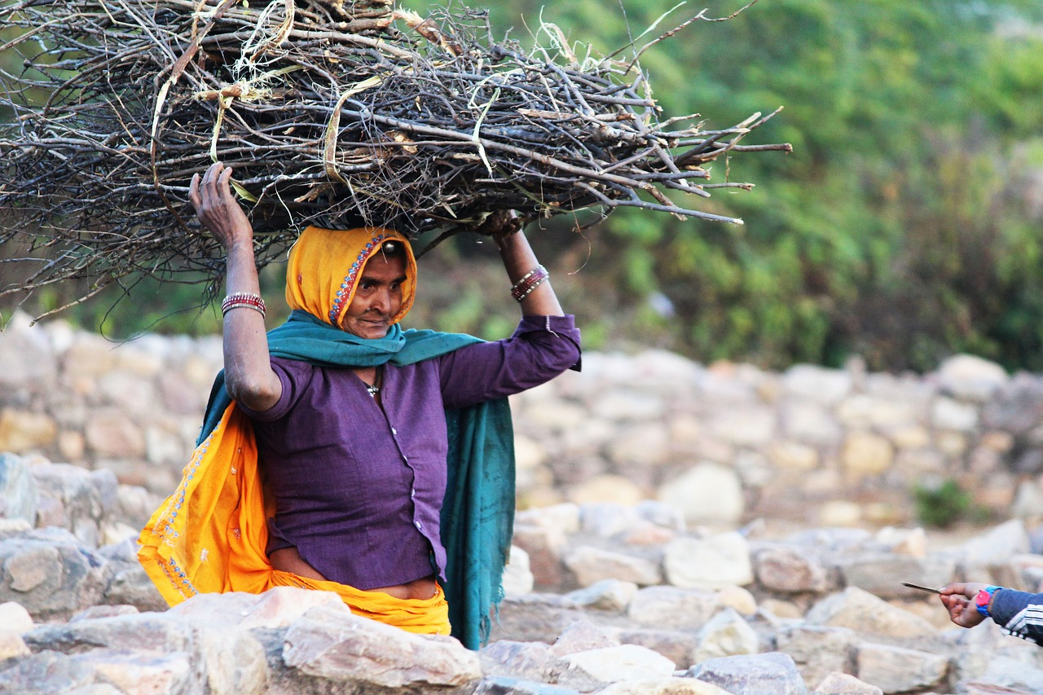
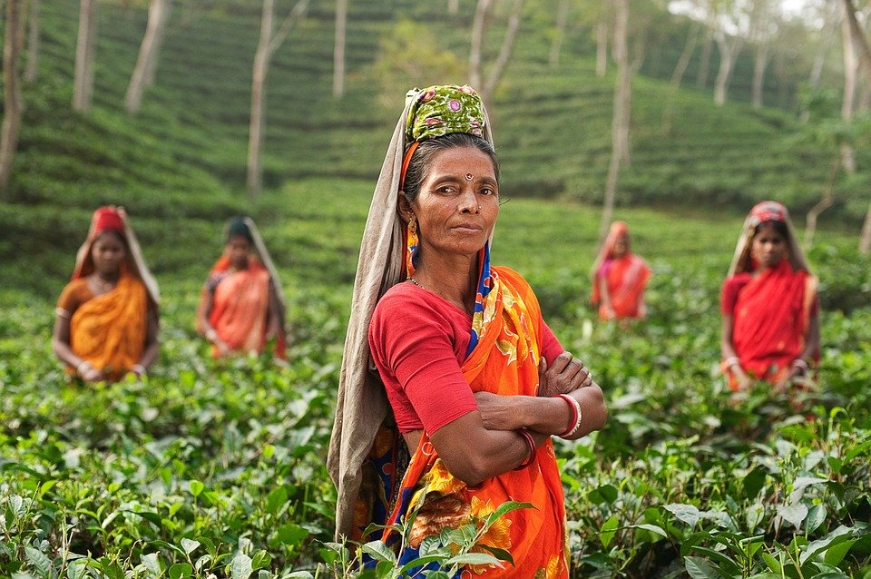
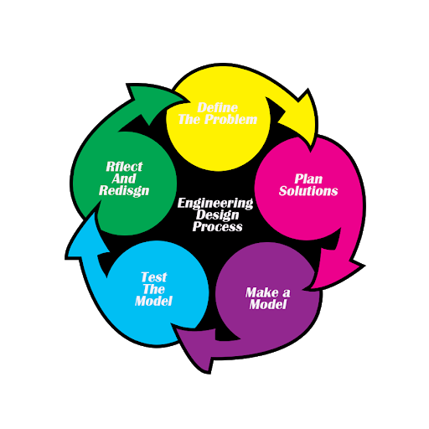
Community Support for Rural Women Empowerment
Gender Equality - 5
Pogula Sai Lakshmi Prasanna Greeshma,Shaik Tabassum Ara,
Naga Sai Sravanth S, Bhavya Kolluru, Suphiya Nawaz
Vasireddy Venkatadri Institute of Technology,Guntur
Most of the woman in rural india are either part of agriculture workers or remain as housewives.They either have less source of income or no sources for Income due to which they are getting biased in family. The reasons we have identified are getting married in early ages , lack of education and skills. So we have taken the problem statement as How to empower rural women?
Decision Matrix
The idea we are suggesting
Makes rural women stand on their own foot
Helps in developing skills with the help of industry experts
Employment with flexible work hours
Involves students of engineering colleges who act as bridge between industry and women of a village
Criteria | Base line | Present idea | Our idea
Flexibility | 5 | 3 | 5
Maintenance | 5 | 3 | 4
Cost | 5 | 3 | 4
Skill | 5 | 2 | 4
Total | 20 | 11 | 17

Slide 3

Problem Identification
IUCEE Student Summit 2020
Based on a survey organized as a part of college event in a nearby village
Women are financially dependent on men
Getting married at very early age
Lack of education and skills
Not considered in decision making
These are the reasons due to which women are getting biased in the family.
So our problem statement is How to empower these rural women?

Slide 4
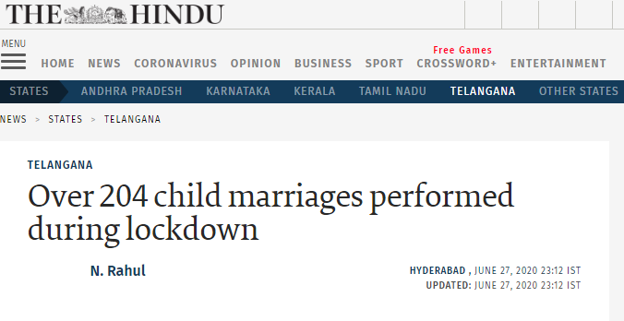

Specification Development
IUCEE Student Summit 2020
Awareness camps and advertisements are pre existing methods followed by government and other non-governmental organizations.
We are witnessing child marriages even in 2020 making clear that these are not creating any impact at rural areas.
Real equality is achieved only when women can stand on their own feet and our solution works on it.

Slide 5

Conceptual Design
IUCEE Student Summit 2020
Link : https://drive.google.com/file/d/1wh507HYNfweWJLwg7UFyScBU4vzfqg8s/view?usp=sharing

Slide 6
How is it different from the existing solution??
IUCEE Student Summit 2020
Gives opportunity to learn skills from industry experts
Provides employment with the support from industry with flexible work hours
Involves students in different phases and helps in skill development of students too
Criteria | Base line | Present idea | Our idea
Flexibility | 5 | 3 | 5
Maintenance | 5 | 3 | 4
Cost | 5 | 3 | 4
Skill | 5 | 2 | 4
Total | 20 | 11 | 17

Slide 7
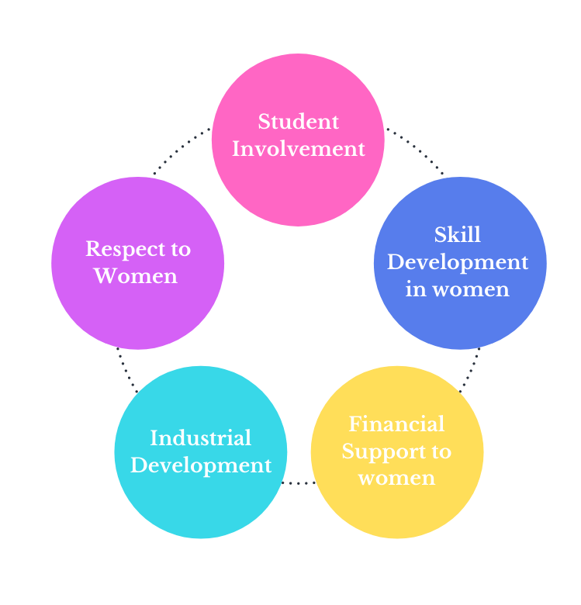
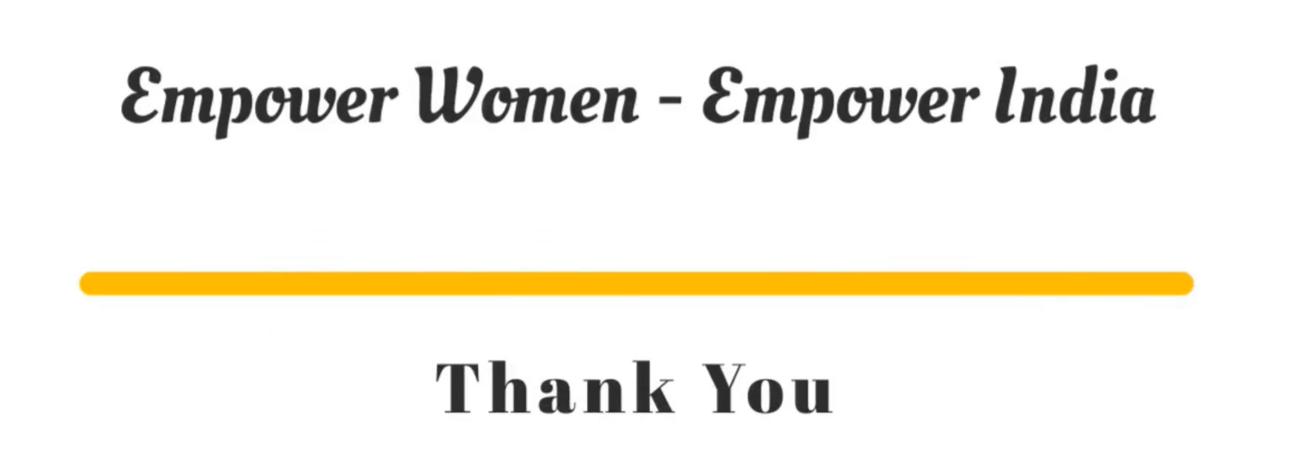
Concluding
IUCEE Student Summit 2020
Pogula Sai Lakshmi Prasanna Greeshma greeshmapogula@gmail.com 9398343011
Shaik Tabassum Ara shaiktabassum0310@gmail.com 6305423238
Naga Sai Sravanth Singamsetty nagasaisravanth456@gmail.com 8688275808
Bhavya Kolluru 19BQ1A0518@vvit.net 9248648345
Suphiya Nawaz suphiyanawazbanu@gmail.com 8885878605

